Slide 1
Python Overview
Keren Finkelstein

Slide 2
Python
Python is an open source programming language that was made to be easy-to-read and powerful.
A Dutch programmer named Guido van Rossum made Python in 1991.
He named it after the television show Monty Python's Flying Circus.

Slide 3
.py files
Python source files
No compilation needed
Execution: $ python /tmp/example.py hello world!

Slide 4
pip
A tool for installing packages (dependencies).
Packages repository: PyPI
Do not install packages globally
documentation

Slide 5
Virtual Environment
A tool to create isolated Python environments.
Creates a folder for all packages that a Python project need.
Allows multiple projects with different (and conflicting) requirements, to coexist on the same computer
virtualenv -p /path/to/python env source env/bin/activate
Documentation
Virtualenvwrapper

Slide 6
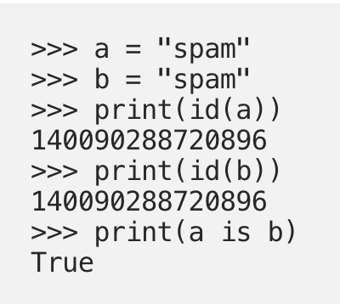
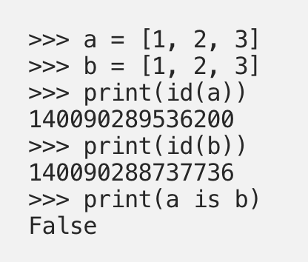
Everything is an object, and Some Objects are Mutable
Mutable and Immutable:
If a = b ( a and b are lists) - both reference the same list object

Slide 7
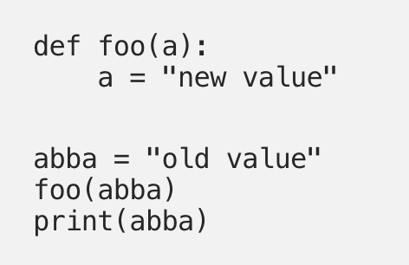
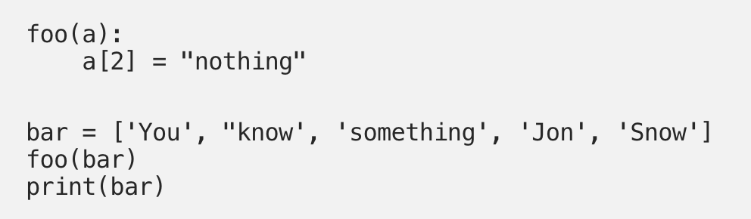
Implications of passing mutable vs. immutable variables to functions
Mutable and Immutable:

Slide 8
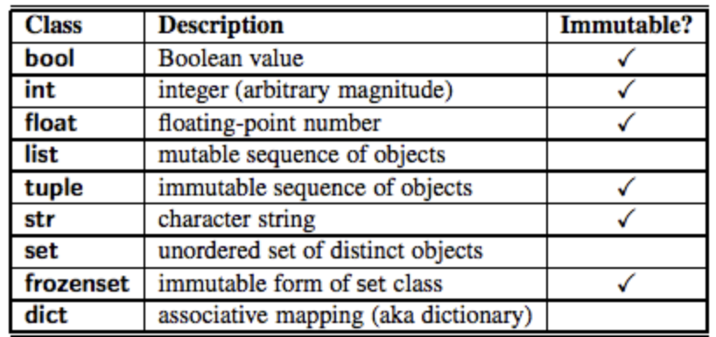
Mutable \ Immutable

Slide 9
Functions
Function declaration doesn’t specify return type
All functions return a value (None if not specified)
Parameter data types are not specified (in python3 you can) def sum(a, b): return a+b sum(1, 2) → 3, sum(‘a’, ‘b’) → ‘a b’
All parameters (arguments) are passed by reference.

Slide 10
Exercises
Write a Python function that accepts a string and calculate the number of uppercase letters and lowercase letters
Write a Python function that takes a list and returns a new list with unique elements of the first list
Write a function that accept a string containing multiple words and print back to the user the same string, except with the words in backwards order.
Write a Python function that checks whether a passed string is palindrome or not (A palindrome is string that reads the same backward as forward)

Slide 11
Exercises - cont’
Write a function to convert a list of multiple integers into a single integer ([11, 33, 77] → 113377)
Find missing and additional values in two lists
Write a Python function to match key values in two dictionaries. Sample dictionary: {'key1': 1, 'key2': 3, 'key3': 2}, {'key1': 1, 'key2': 2} Expected output: key1: 1 is present in both dictionaries
Find the difference between 2 dictionaries: print which key added, removed, same or changed (in that case, print also the value before and after)

